Slide 1

PILDERA 2

Slide 2
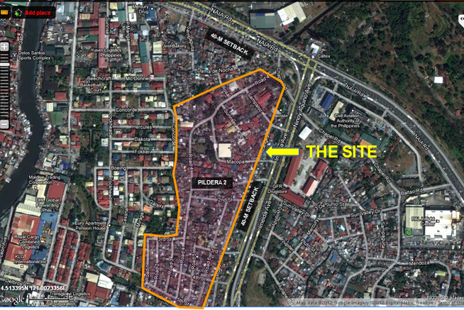
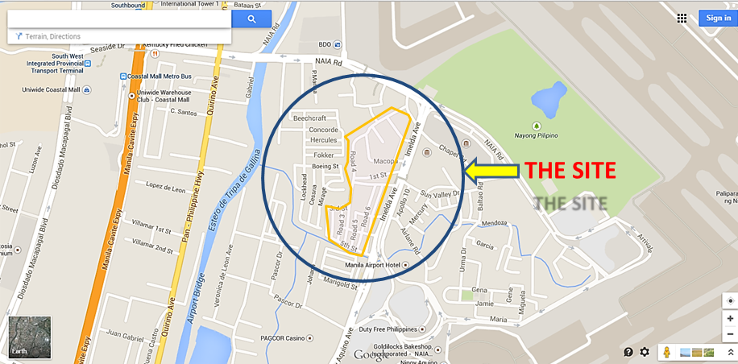
PROJECT PROFILE / VICINITY MAP
LANDOWNER : | MIAA
COVERED BY APD/PPs/EO no: | Proclamation No. 595 dated 02 April 2004 as amended by Proclamation No. 1027
LOCATION: | Pildera 2 Village, Brgy. San Roque, Pasay City
LOT AREA: | 143,279 sq.m.
EXISTING SITE CONDITION/ FEATURES: | * Fully occupied by ISFs and former leases/ employees of CAA in 1960s * With concrete roads, drainage system and water supply system. 3,393 Households
PROPOSED HOUSING PROGRAM/ SCHEMES: | LRB Housing Development

Slide 3
